Slide 1
SWE215 Final Presentation
Team 1 | K-Maintenance
Hashim Al-Ghamdi
Haitham Al-Saeed
Salem Bamukhier
Salman Al-Ghamdi

Slide 2
Vision Statement

Slide 3
Problem Statement
KFUPM residents have had complaints about the maintenance service that’s offered in the university and they included:
Long waiting times for service.
Unsatisfactory fixing of problems and overall poor service.
Lack of clarity on how to specifically report or describe problems.

Slide 4
Product Overview
K-Maintenance is a shortened name for KFUPM Maintenance
It’s envisioned to automate the process of requesting services and to make it easier and more seamless.
Requests can be attached with a textual description, an image or a video.
The time for serviceman arrival will be calculated and estimated to ease the user’s mind.

Slide 5
Functional Requirements
The system shall allow the admin to sort requests
The system shall allow the user to select from pre-set frequent, common requests.
The system shall save the user’s preferred location.
The system shall limit the user’s requests to one request per category.

Slide 6
Non-Functional Requirements
The system shall be interoperable so that the KFUPM login system can be used for it.
The system shall be available at most times and scheduling for maintenance should be during low-traffic periods.
The system shall prevent any attempt to spam requests to improve the admin’s usability.
The system shall be platform independent; it should be available on multiple operating systems.
The system shall be reliable so that the user can trust the system to match their expectations when executing operations.

Slide 7
Stakeholders
KFUPM administration
KFUPM students
KFUPM faculty members
KFUPM residents
KFUPM Maintenance Department

Slide 8
Users and User Characteristics
KFUPM Maintenance Department labor:
- Low technical knowledge
- Smartphone with modest abilities
KFUPM community members:
- Average to high technical knowledge
- Smartphone with average to high abilities
KFUPM Maintenance Department administration:
- Average to high technical knowledge
- PCs and smartphone with high abilities

Slide 9
Constraints, Assumptions & Dependencies
Constraints
- The project must be implemented using the simplified Rational Unified Process.
- UML must be used as a modeling language.
- Modeling work must be done on Enterprise Architect.
Assumptions
- KFUPM Maintenance Department administration is responsible for training labor.
- Existing system that deals with servicemen management (availability, working hours, salary,
reward system, etc.)
Dependencies
- This system is given the ability by KFUPM ICTC Department to use KFUPM Login System.
- Enough budget to complete the project.

Slide 10
Use Case Diagram

Slide 11
Selected Use Cases
Make request
View assigned requests
Track request
Assign service

Slide 12
System Requirements

Slide 13
Use Case Description
Use Case Name:
- Make request
Precondition(s)
- Connection to the internet
- User is logged in to the system
- The user has not reached request limit.
Successful Post Condition
- Request is made
- Serviceman is dispatched
Actors
- User
Priority
- High
Difficulty
- Low

Slide 14
Main Flow & Alternative Flows
Main Flow
The use case begins when the user enters the homepage after logging in.
The user selects “Make request”.
The user specifies type of request.
The user adds a brief description of the problem.
The user specifies request’s location.
The user confirms the request.
End use case.
Alternate flows:
2.1.1 Display message of “Request limit has been reached, try again in *Time countdown for next request* ”.
2.1.2 Go to 7.
6.1.1 Display message of “Our servicemen are busy; your request cannot be handled at specified time”.
6.1.2 Display options of “Add request to queue” , “Change request details” and “Cancel request”.
6.1.2.1 Request is added to the queue.
6.1.2.2 Go to 3.
6.1.2.3 Go to 7.

Slide 15
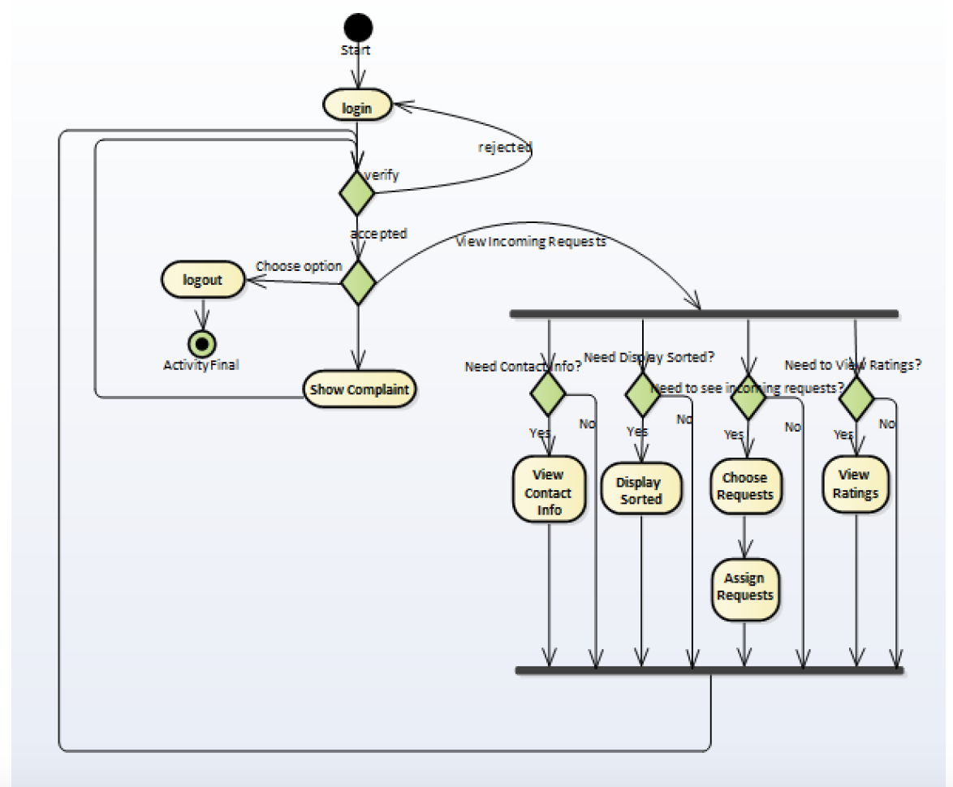
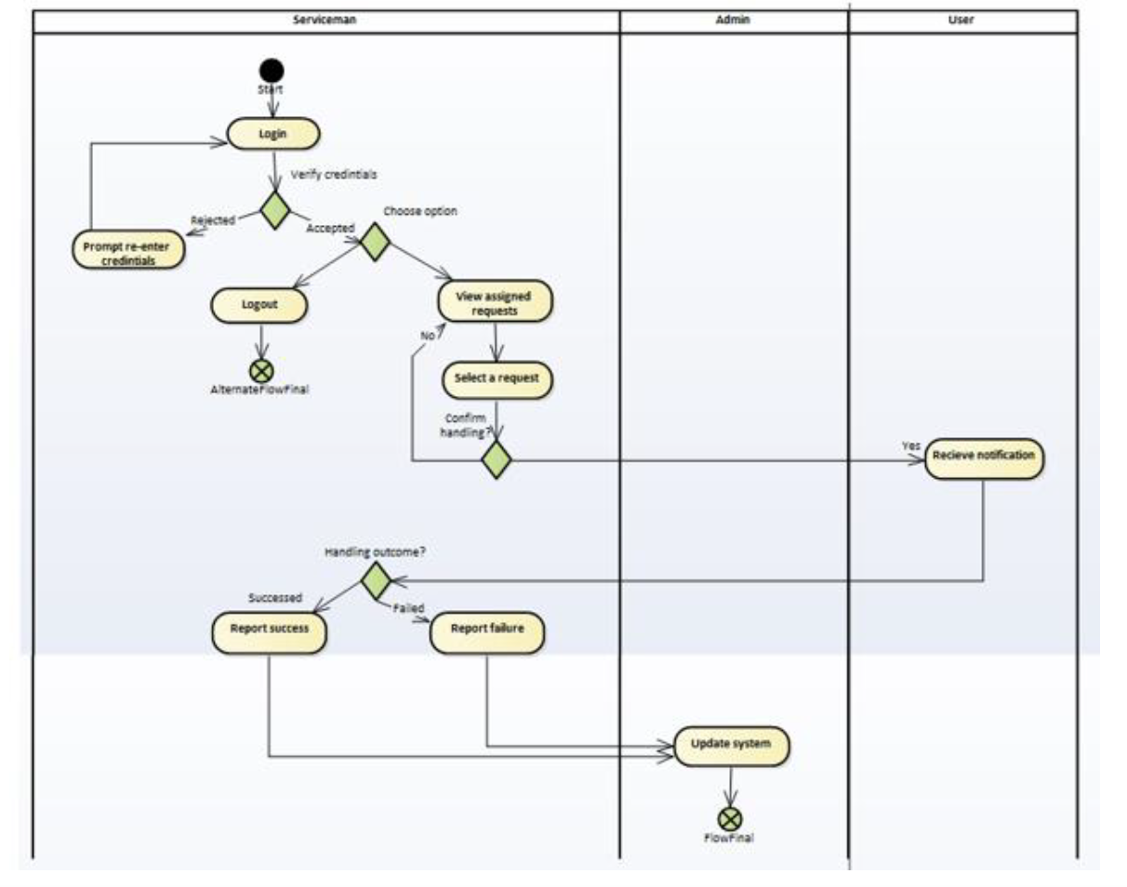
Activity Diagrams
Admin
Serviceman

Slide 16
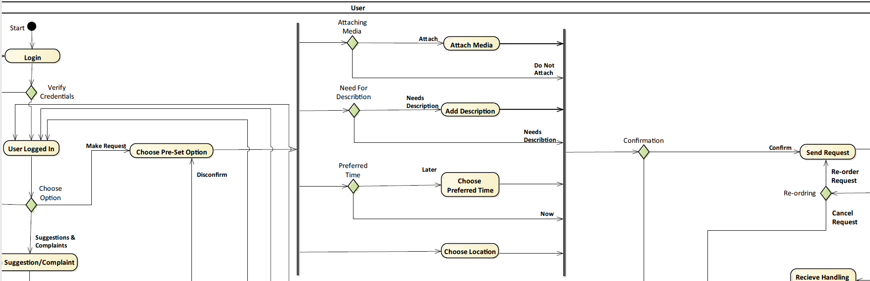
User

Slide 17
Analysis Models

Slide 19
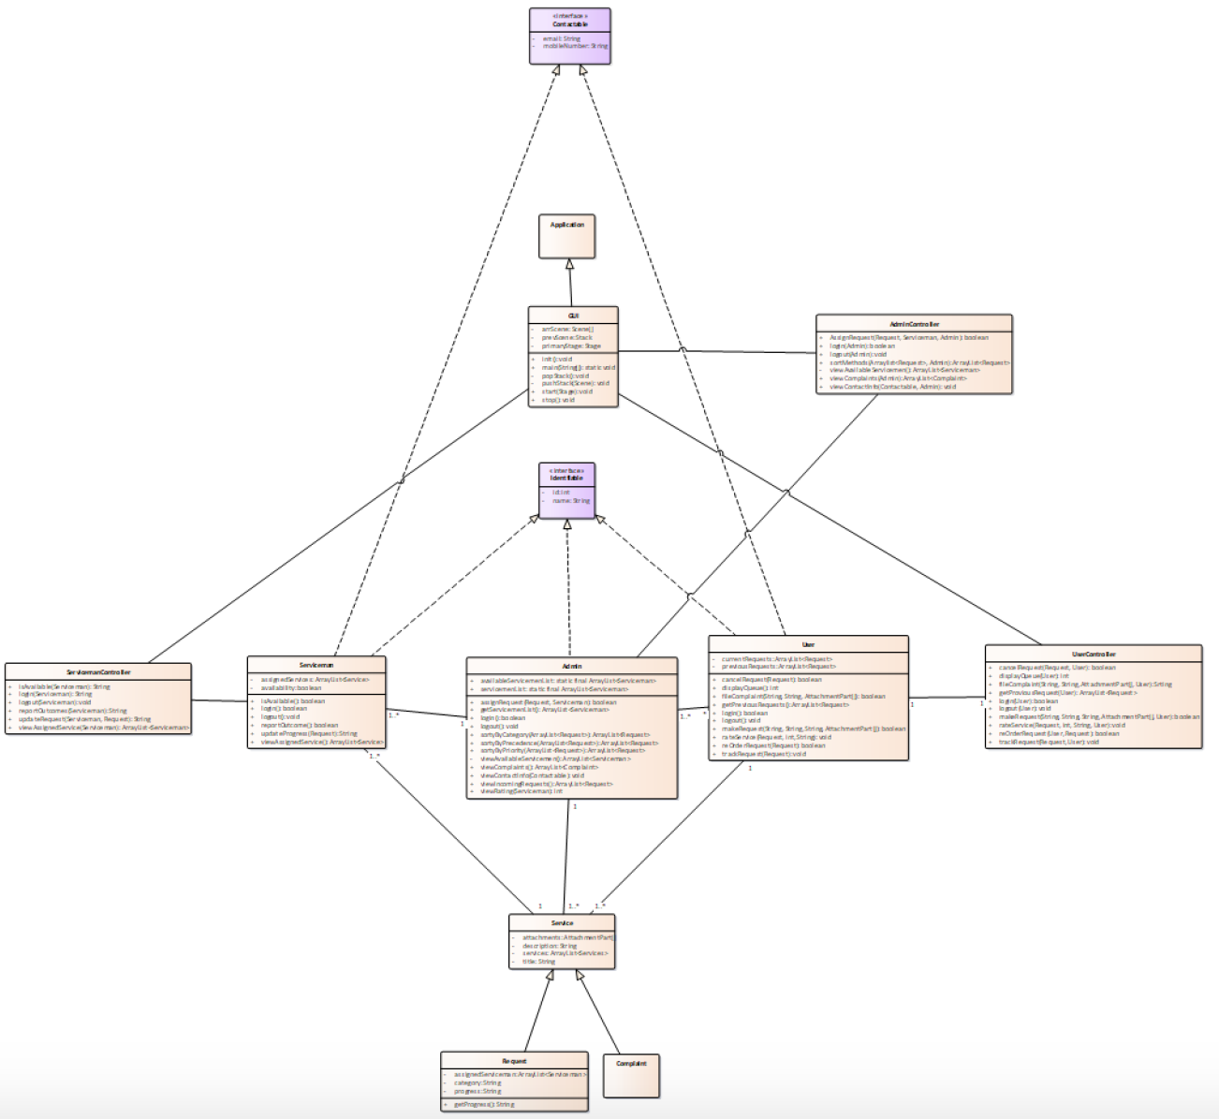
Class Diagrams

Slide 20
Model classes

Slide 21
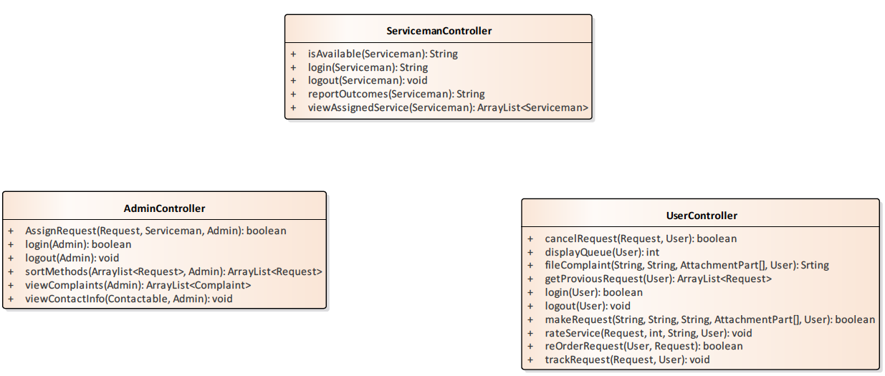
Control classes

Slide 22
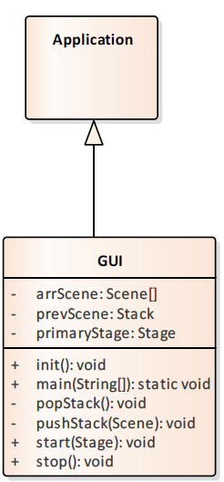
Control classes

Slide 23
Sequence Diagrams

Slide 24
Prototype Sketches

Slide 25
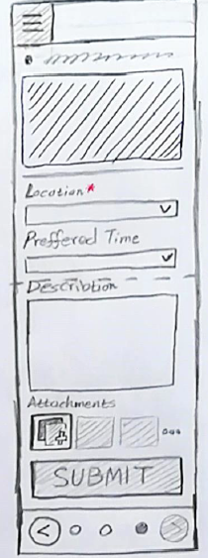
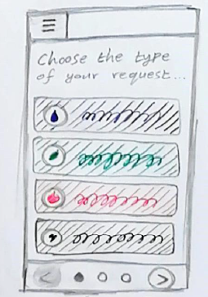
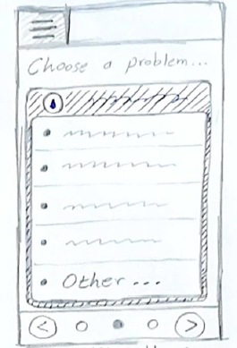
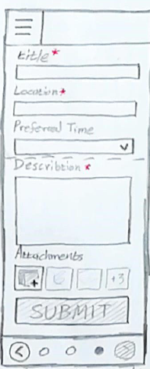
Make Request

Slide 26
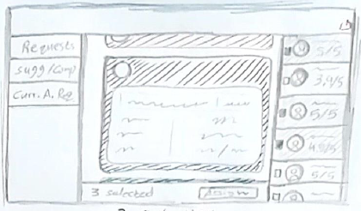
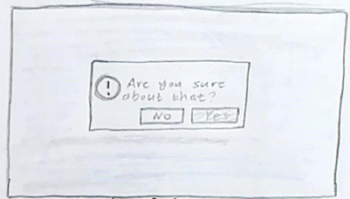
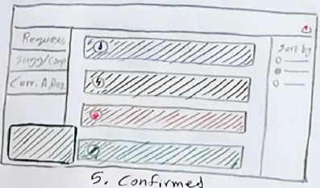
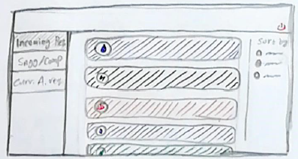
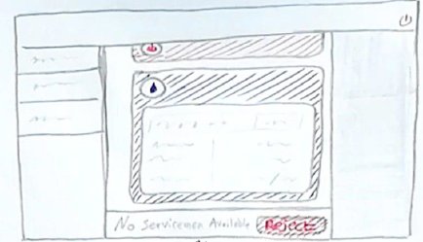
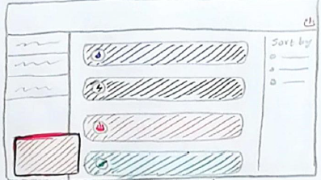
Assign Request

Slide 27
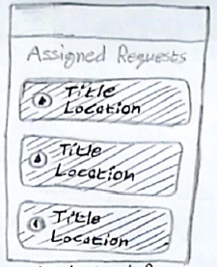
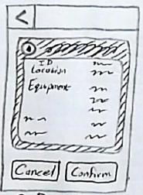
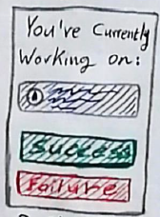
Assign Request

Slide 28
Thank you for listening
Any questions? Issues? Concerns?

